Slide 1
Group 2 TriHub Sprint 3
Stephen Agbenu, Mohamed Bouh, Aaron Lewis, Young Kim, Matthew Rinoldo

Slide 2
Sprint 3 purpose
Small sprint
Create methods for functionality

Slide 3
Completed User stories
Completed 5 issues
Short list due to sprint purpose

Slide 4
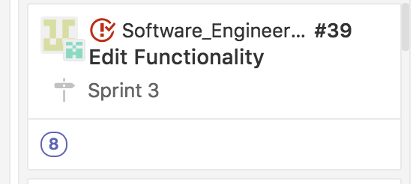
Completed Story: Edit Functionality
Deleted extra buttons
Added buttons for help and refresh
Added functionality in UI to allow admin to set up specific schedule for groups

Slide 5
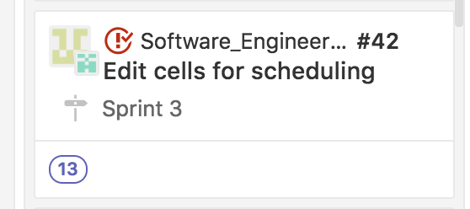
Completed story: Edit cells for scheduling
Added ability to click check box for each user used for scheduling groupings of students

Slide 6
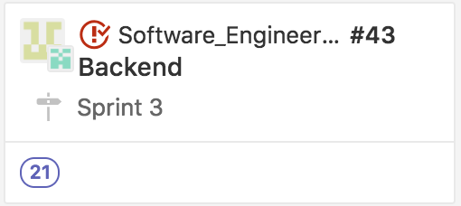
Completed Story: backend
Determine what functions need to be deleted
Determine how to post to Database
Worked on function that writes users to specific schedule and posts to database

Slide 7
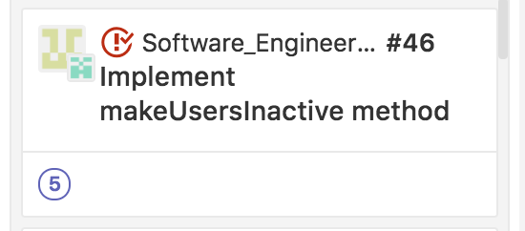
Completed story: implement makeuserinactive method
Method takes list of UserID that correspond to people
Creates a list that keeps track of UserID that are inactive
Keeps track what time inactive IDs are scheduled for

Slide 8
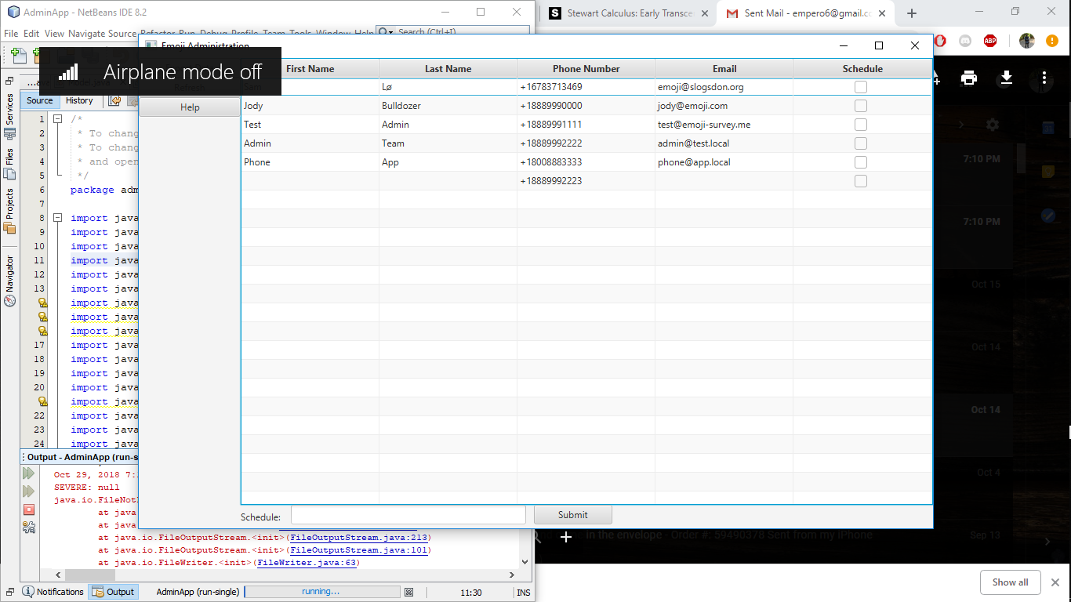
Beta program

Slide 9
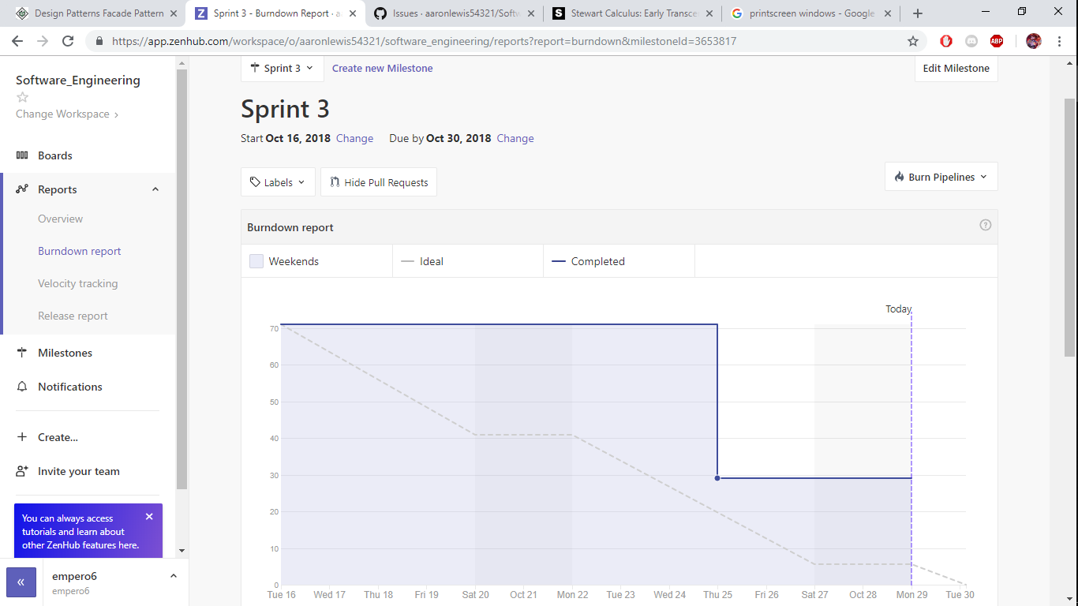
Scrum Burndown Chart

Slide 10
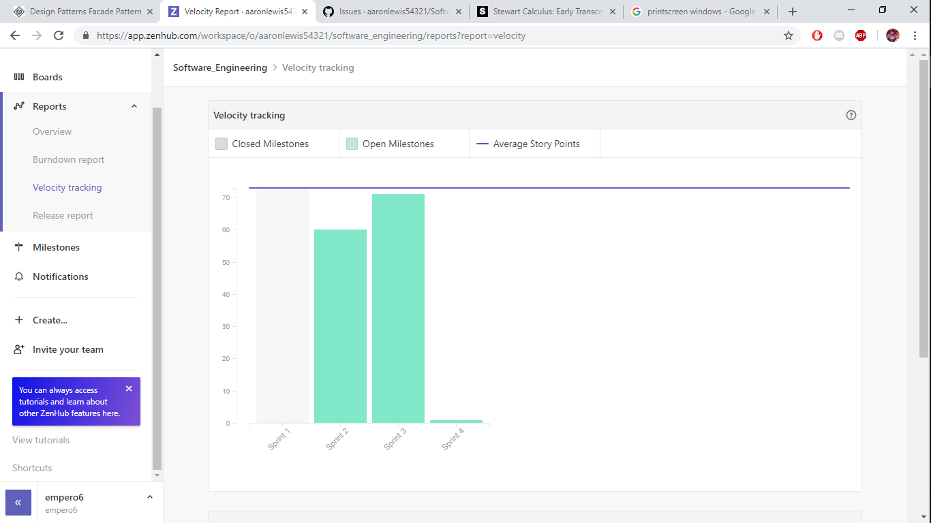
Velocity Chart

Slide 11
Team Backlog

Slide 12
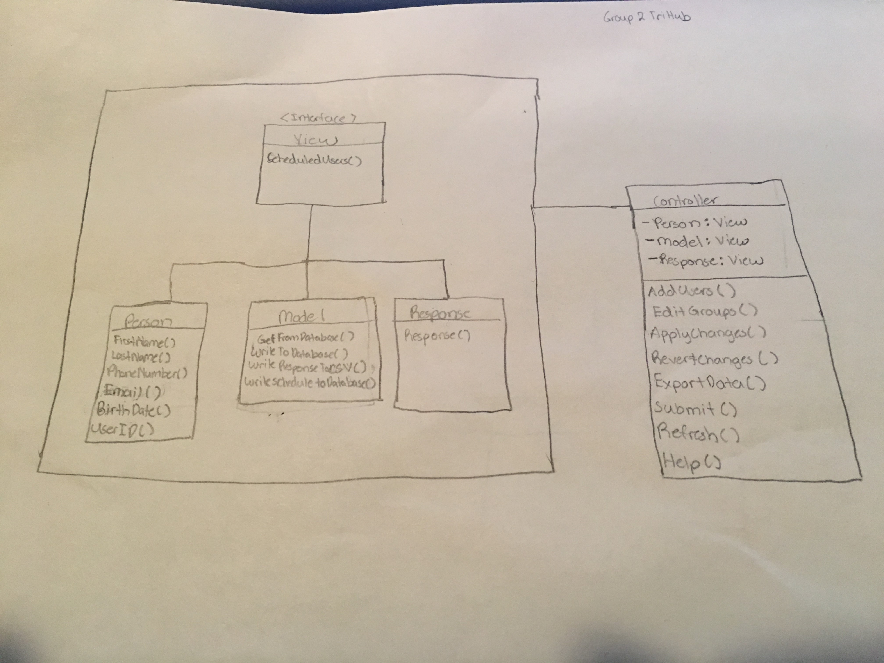
Façade Design diagram

